Slide 1

Leoni luca
Locarno silvia
Minotti luca
CLUP
1st February 2021

Slide 2
[G.1] Allows Store Managers to regulate the influx of the people in their store
[G.2] Allows Customers to line up from their home
[G.3] Allows Guests to line up physically from a store
GOALs
part 1

Slide 3




GUEST
Actors
CUSTOMER
STORE MANAGER

Slide 4
[G.6] Allows Customers to book a visit to a specific store in a specific date
[G.9] Provides Customers with periodic notifications about available slots in the day/time range they usually shop
[G.4] Allows Store Manager to keep access data under control
GOALs
part ii

Slide 5
[D.1] No client, be it a Customer or a Guest, can enter a store without having shown a QR code at the entrance
[D.2] No client, be it a Customer or a Guest, can leave a store without having shown a QR code at the exit
DOMAIN ASSUMPTION

Slide 6
QR code readers positioned in front of all the entrances and exits of the buildings
Remotely controllable sliding doors
A device to show which Store Clients are allowed to enter the store
A device that allows Guests to receive paper ticket.
Specific REQUIREMENTS

Slide 7
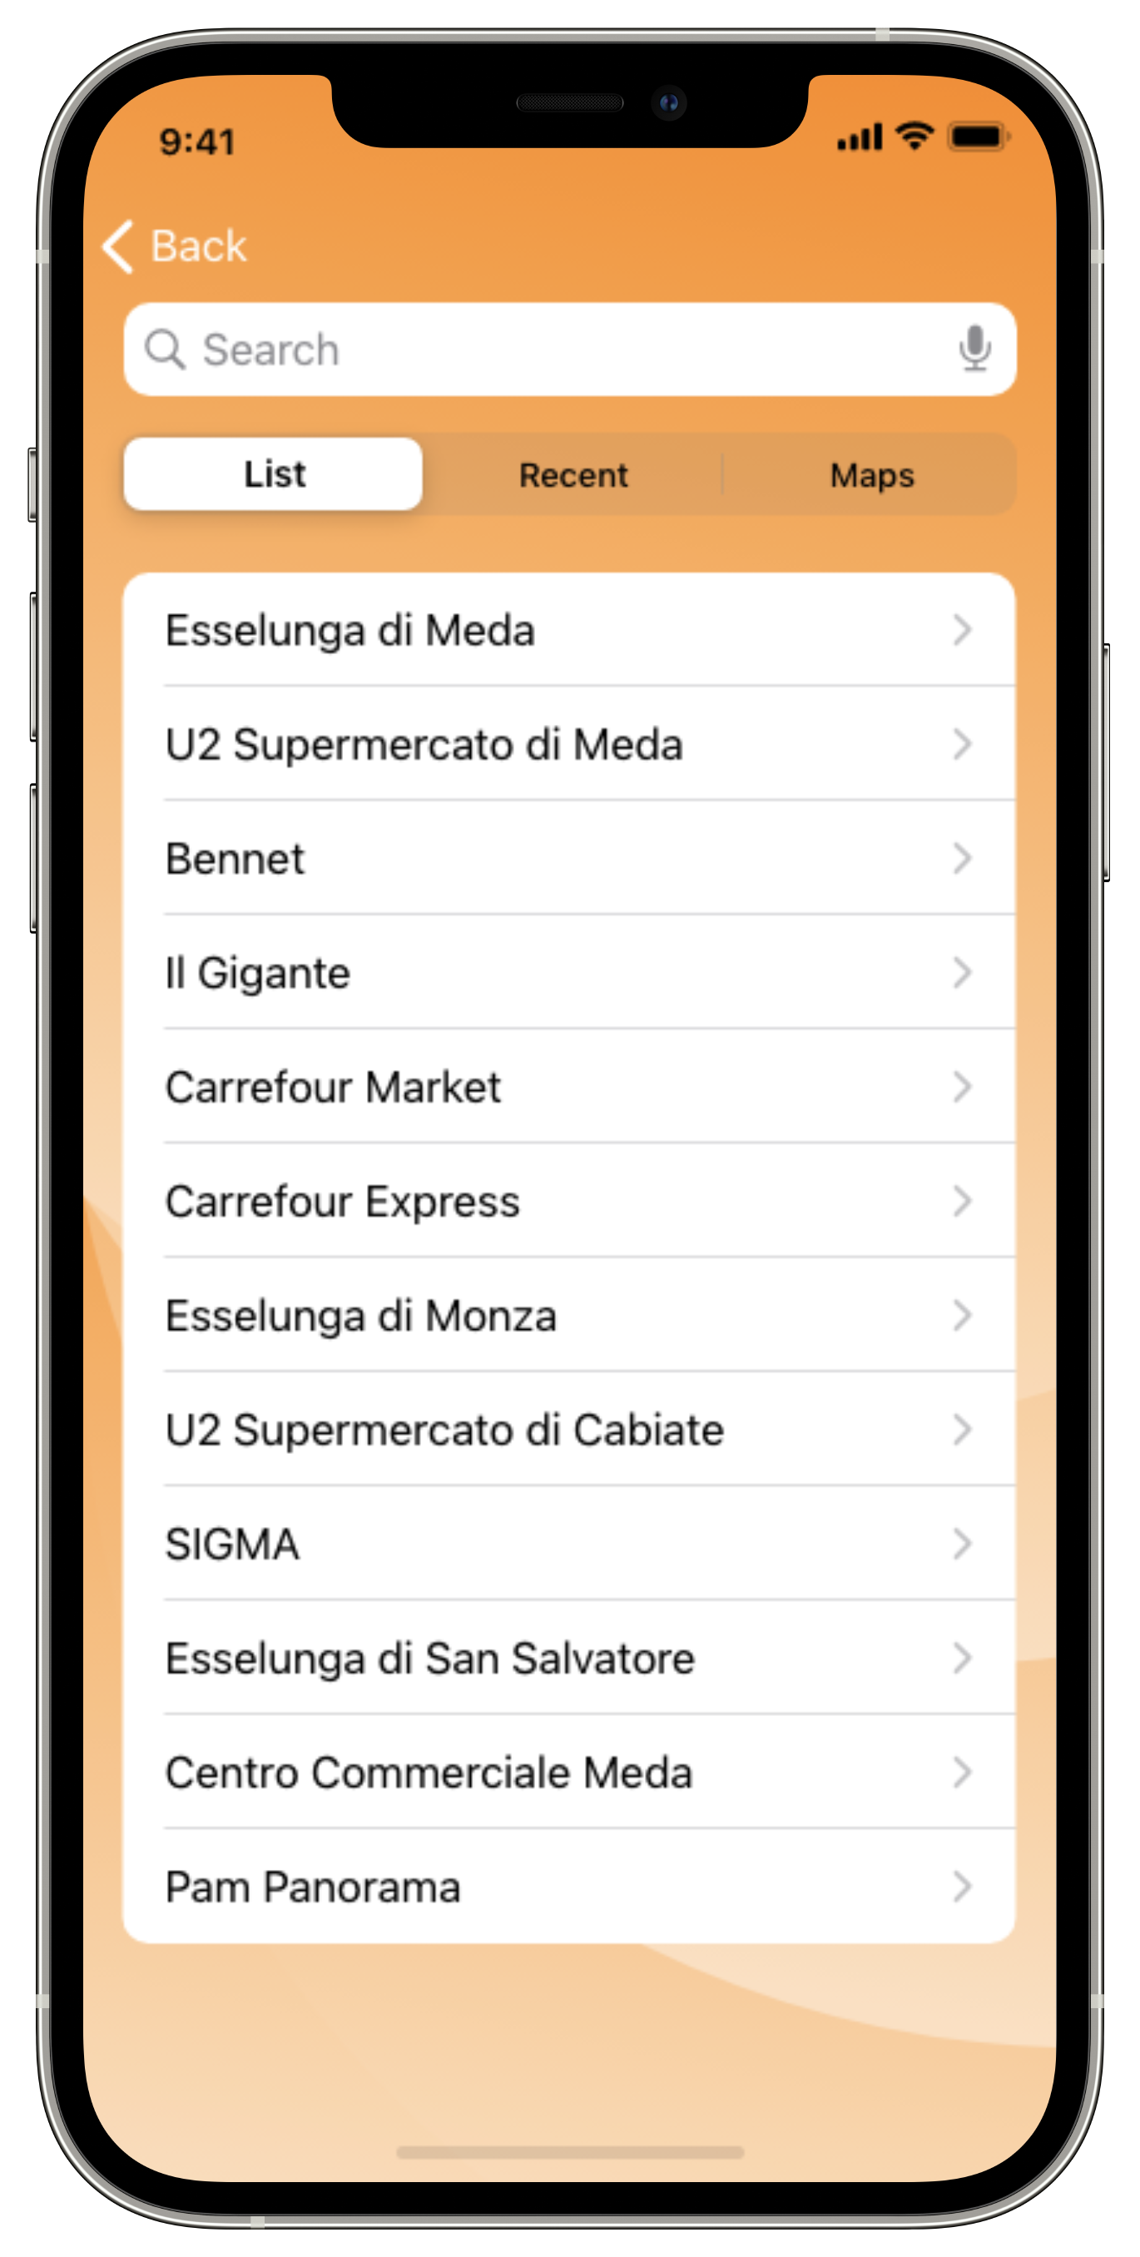
[UC.5] CUSTOMER LINE UP

Slide 8
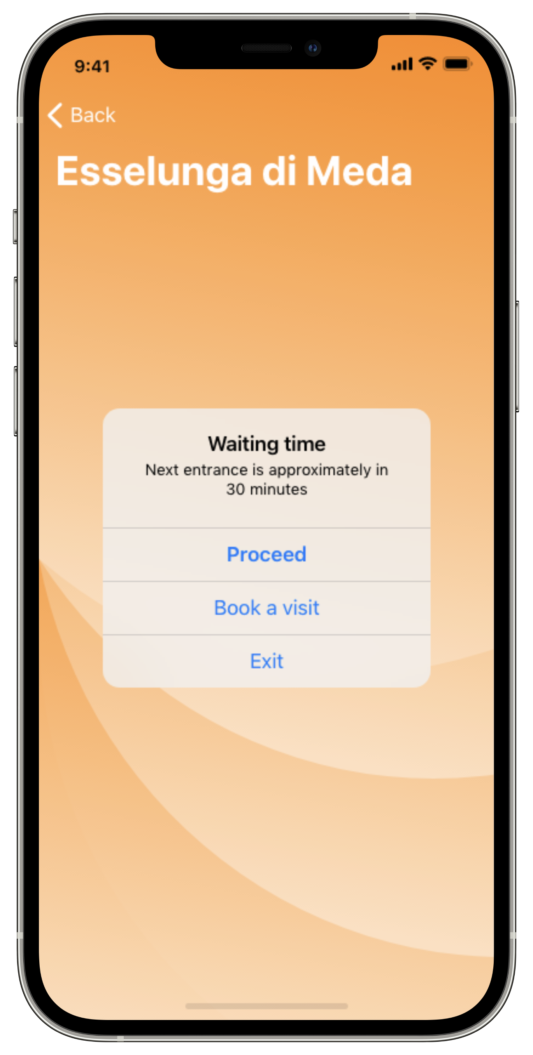
[UC.5] CUSTOMER LINE UP

Slide 9
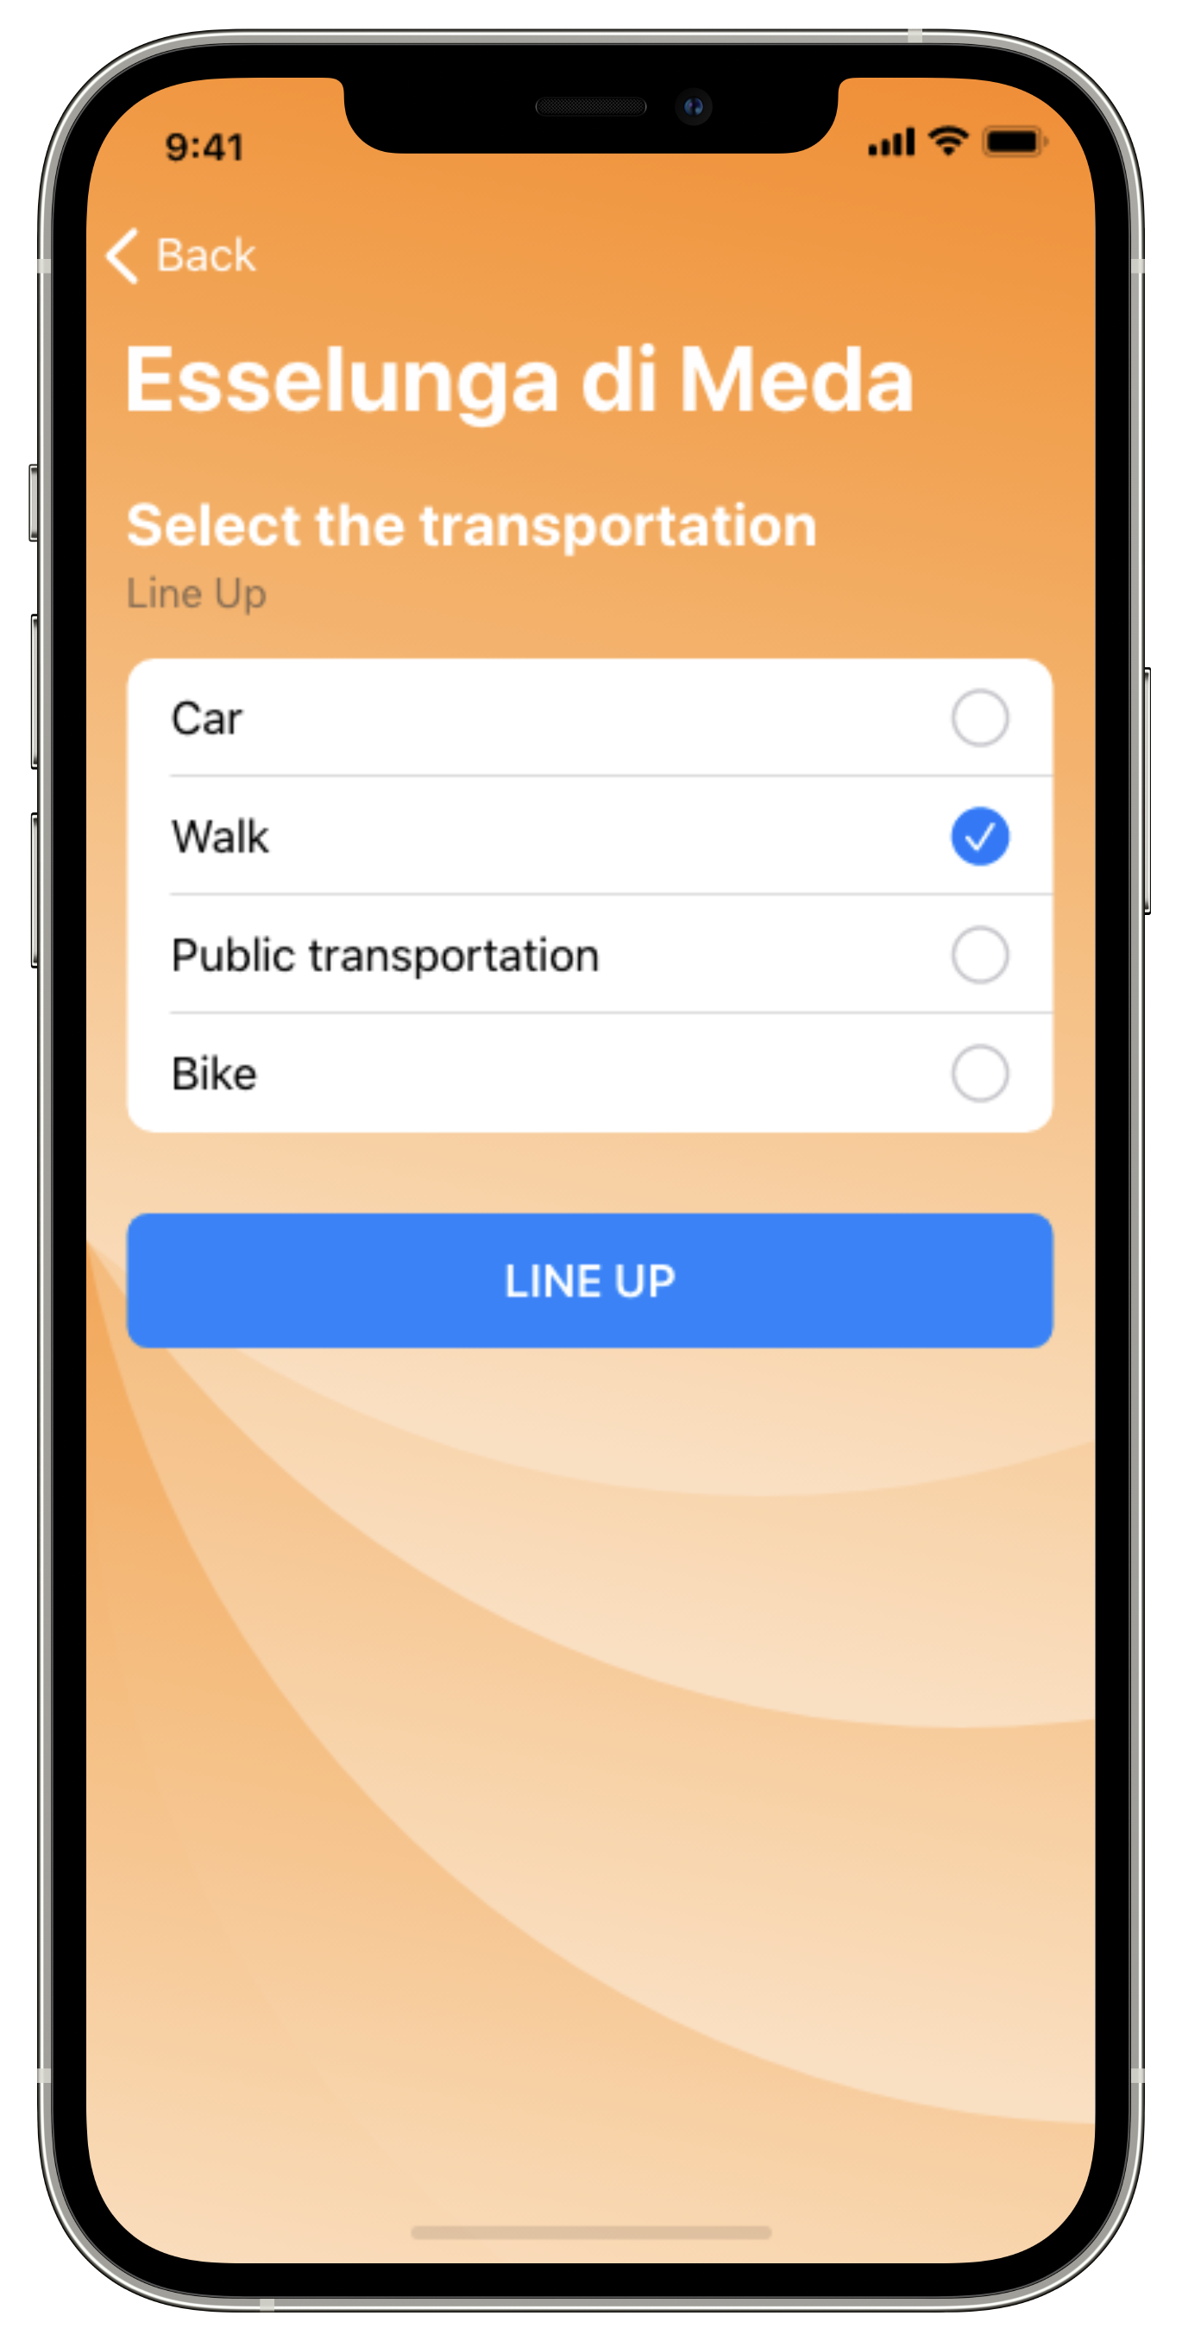
[UC.5] CUSTOMER LINE UP

Slide 10
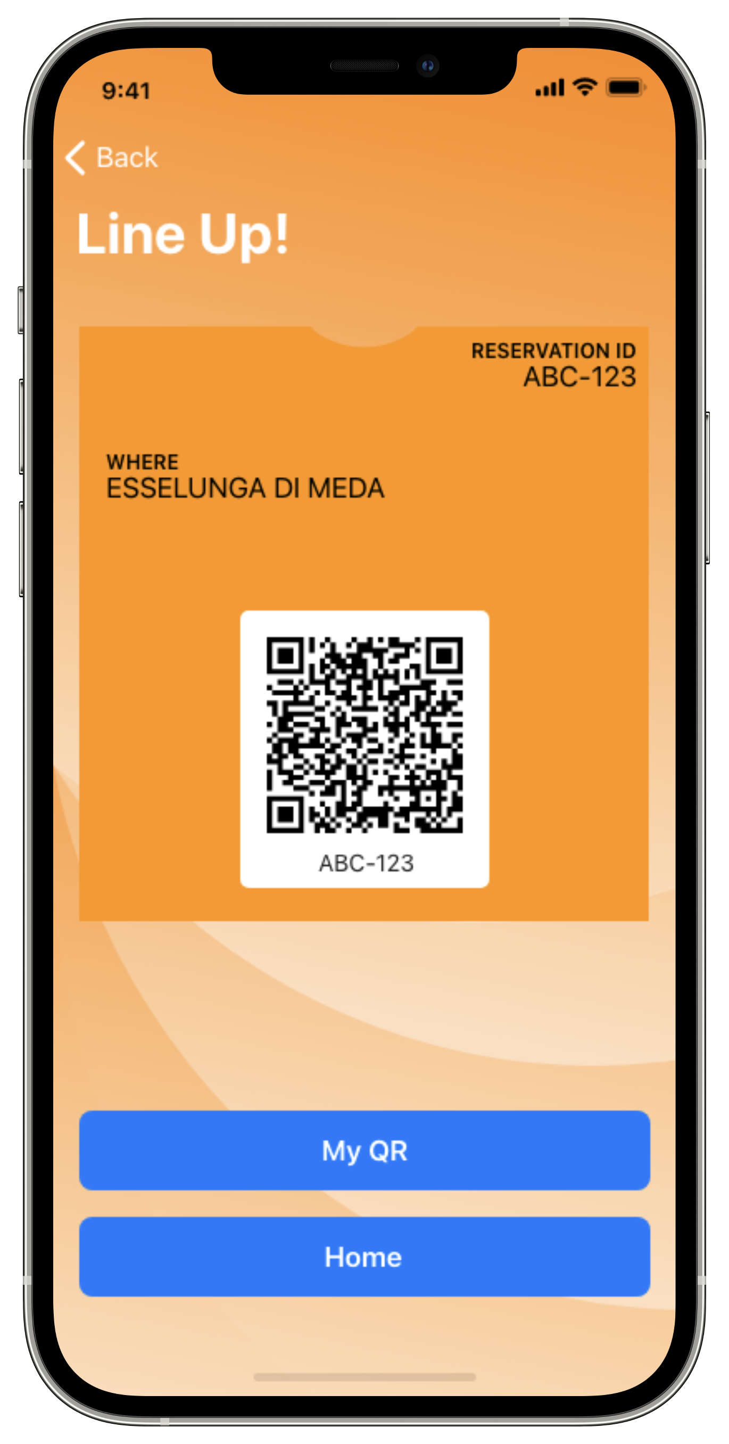
[UC.5] CUSTOMER LINE UP

Slide 11
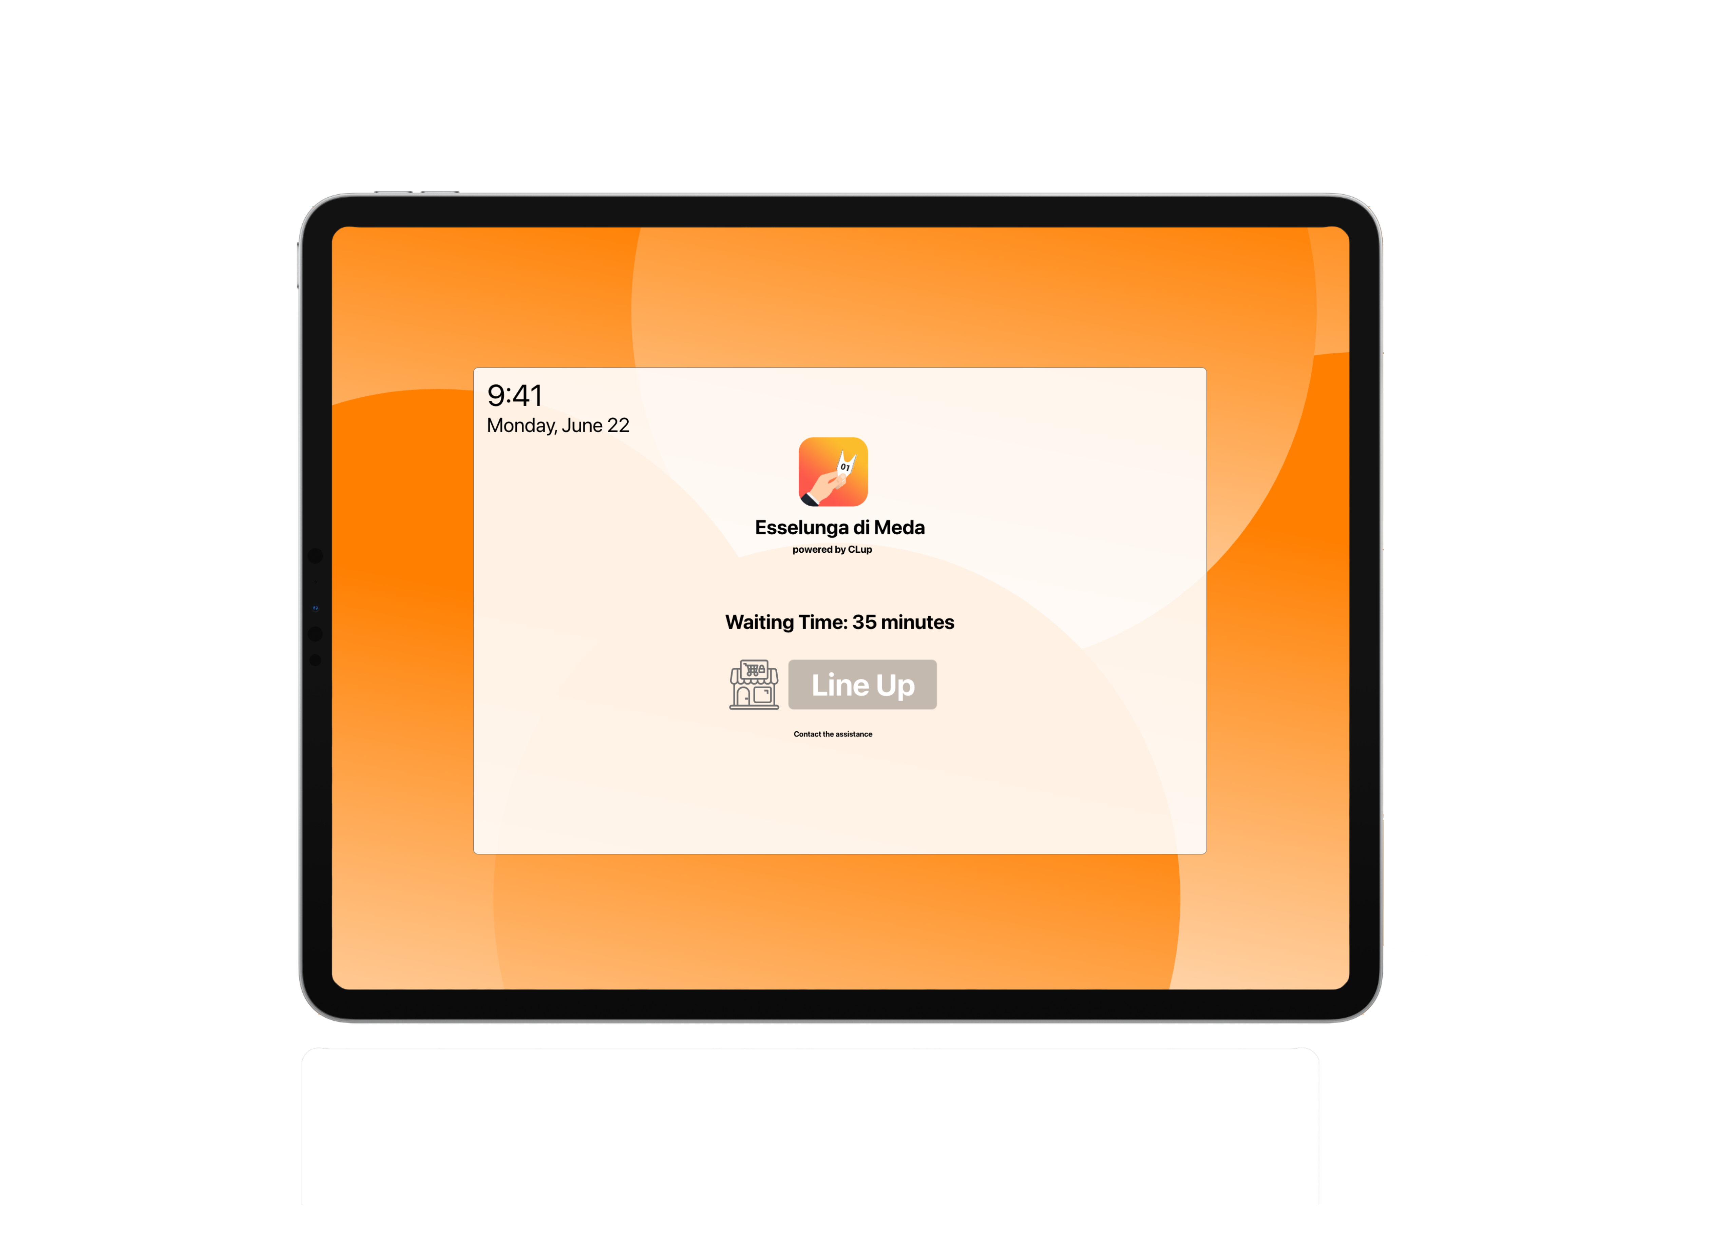
[UC.7] GUEST LINE UP

Slide 12
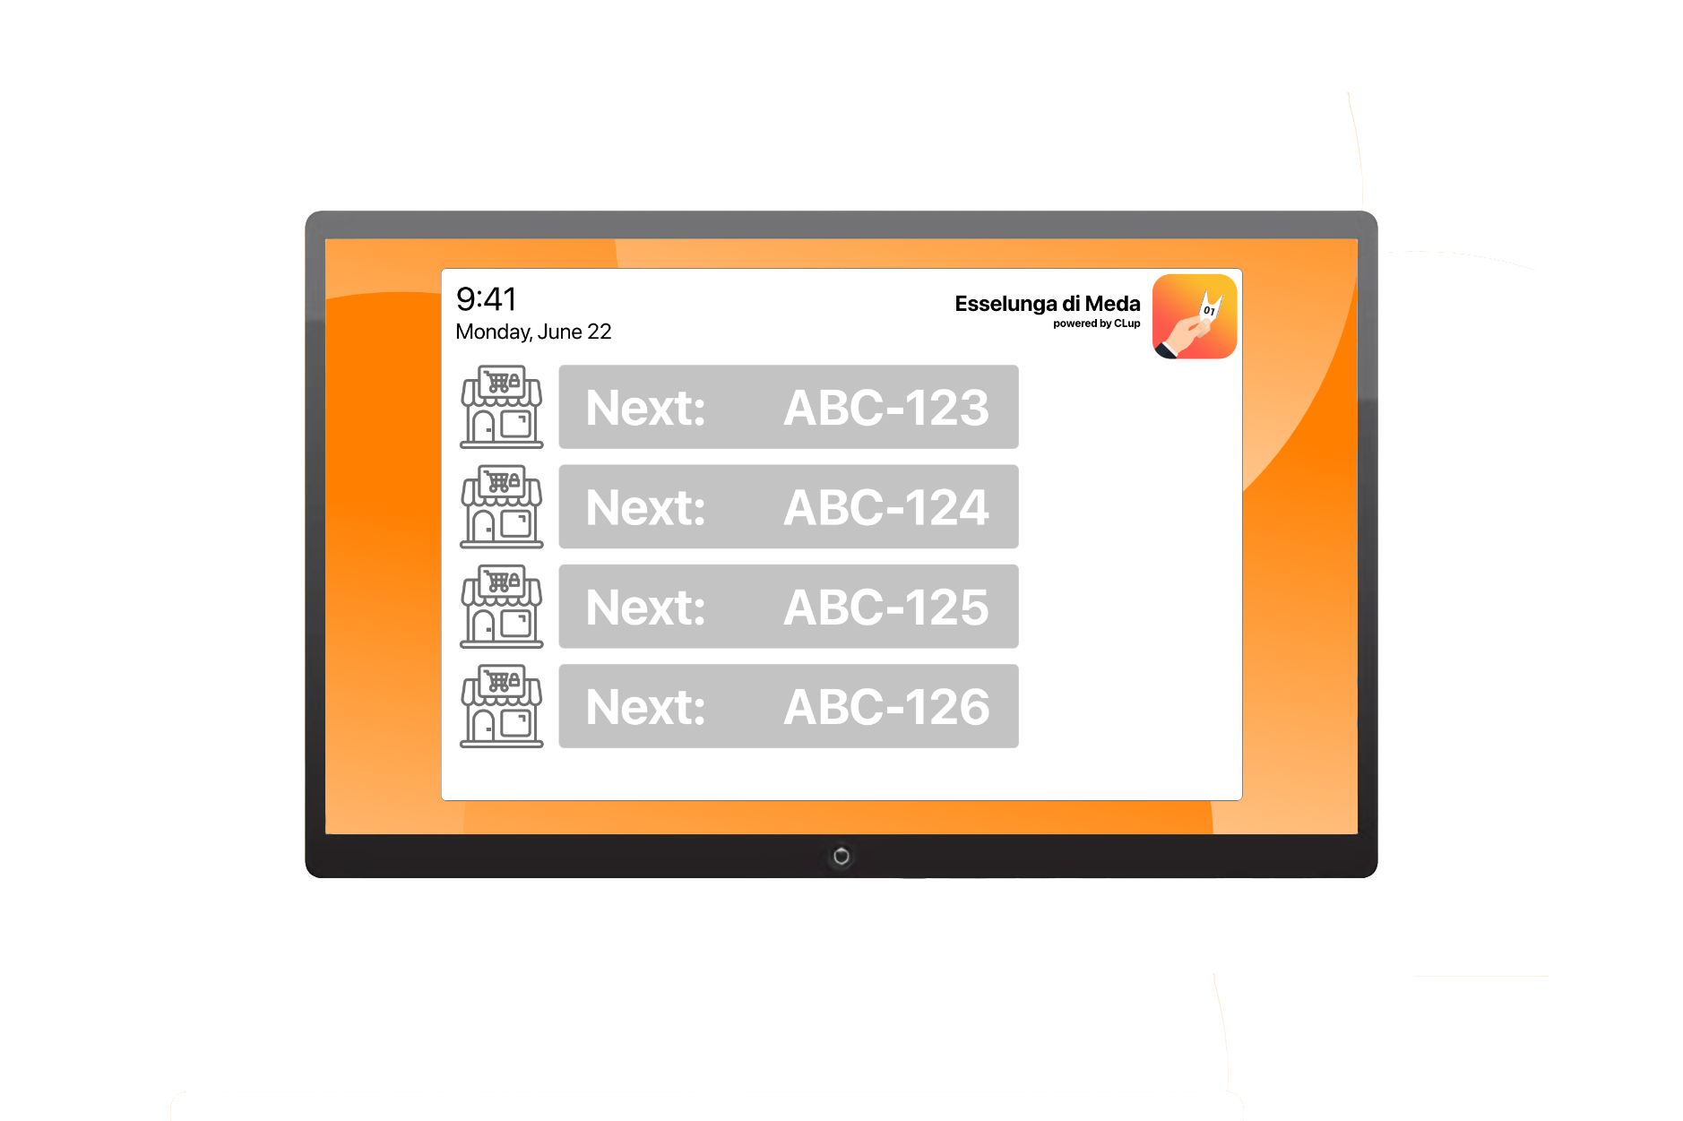
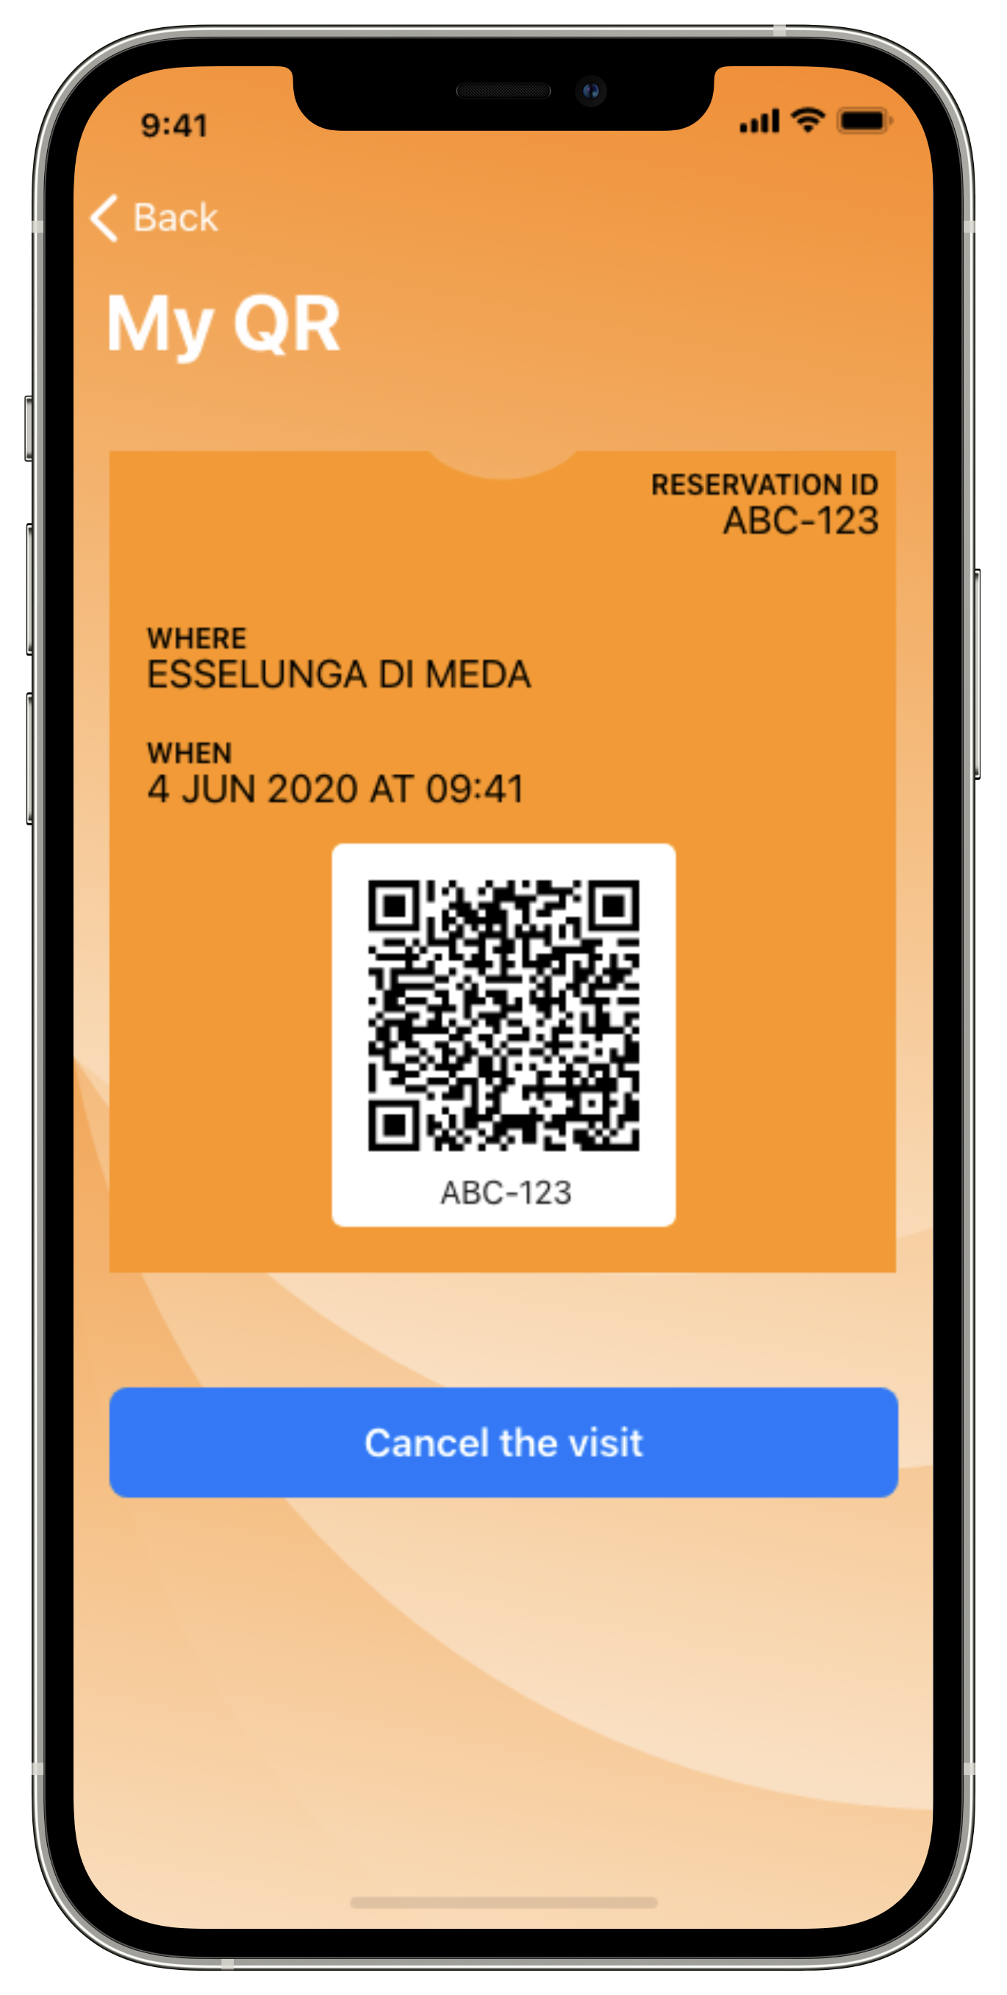
[UC.10/11] CUSTOMER/GUEST ENTERS A STORE

Slide 13
[R.9][R.10][R.11][R.12]
The System must be able to generate tickets and associate them a unique identifier
[R.14][R.15][R.16]
The System must be able to read QR codes at the entrance/exit and control the sliding doors of a store
[R.21]
The System must store historical data in order to compute estimations and schedule the visits
REQUIREMENTS

Slide 14
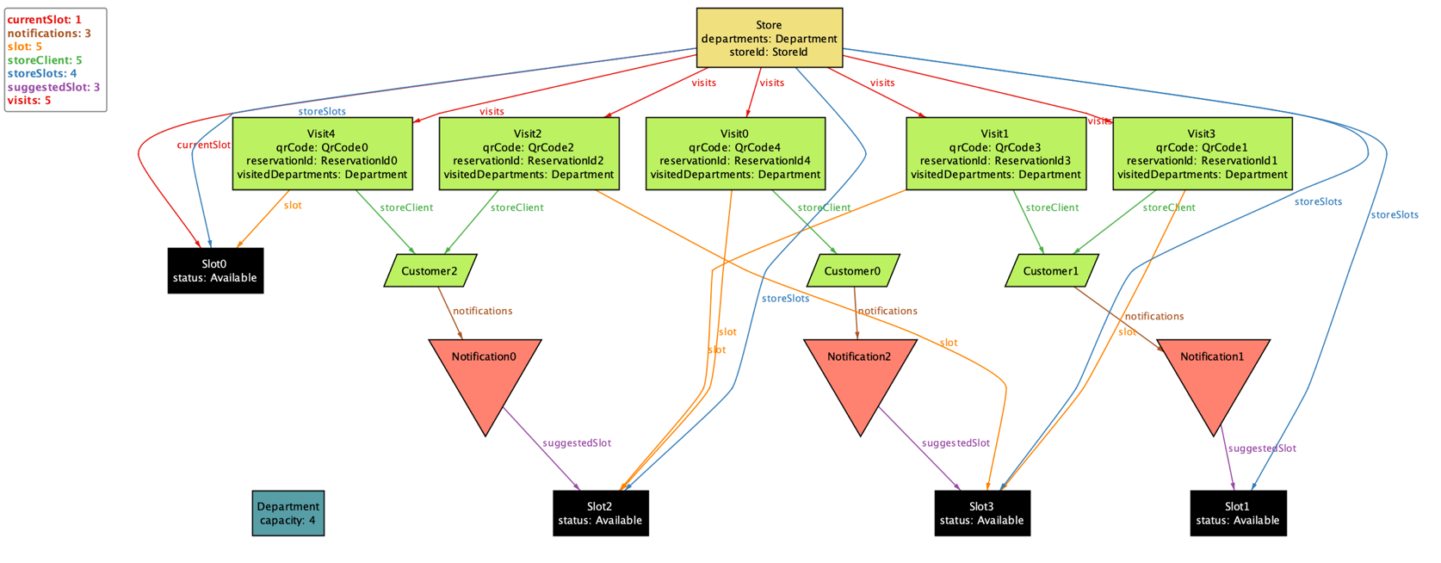
ALLOY MODEL
The Alloy model focuses on the following aspects of CLup:
The capacity of the departments must always be respected
Access to the store must be allowed only to those who have lined up/booked a visit through CLup

Slide 15
SYSTEM OVERVIEW
The components which constitute the System are organized in a 4-tier architecture.
Main advantages:
Maintainability
Scalability
Speed-up the development

Slide 16
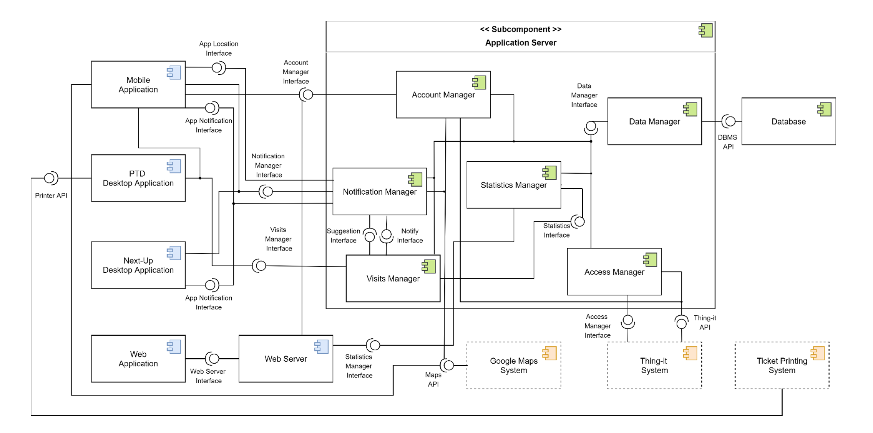
COMPONENT DIAGRAM

Slide 17
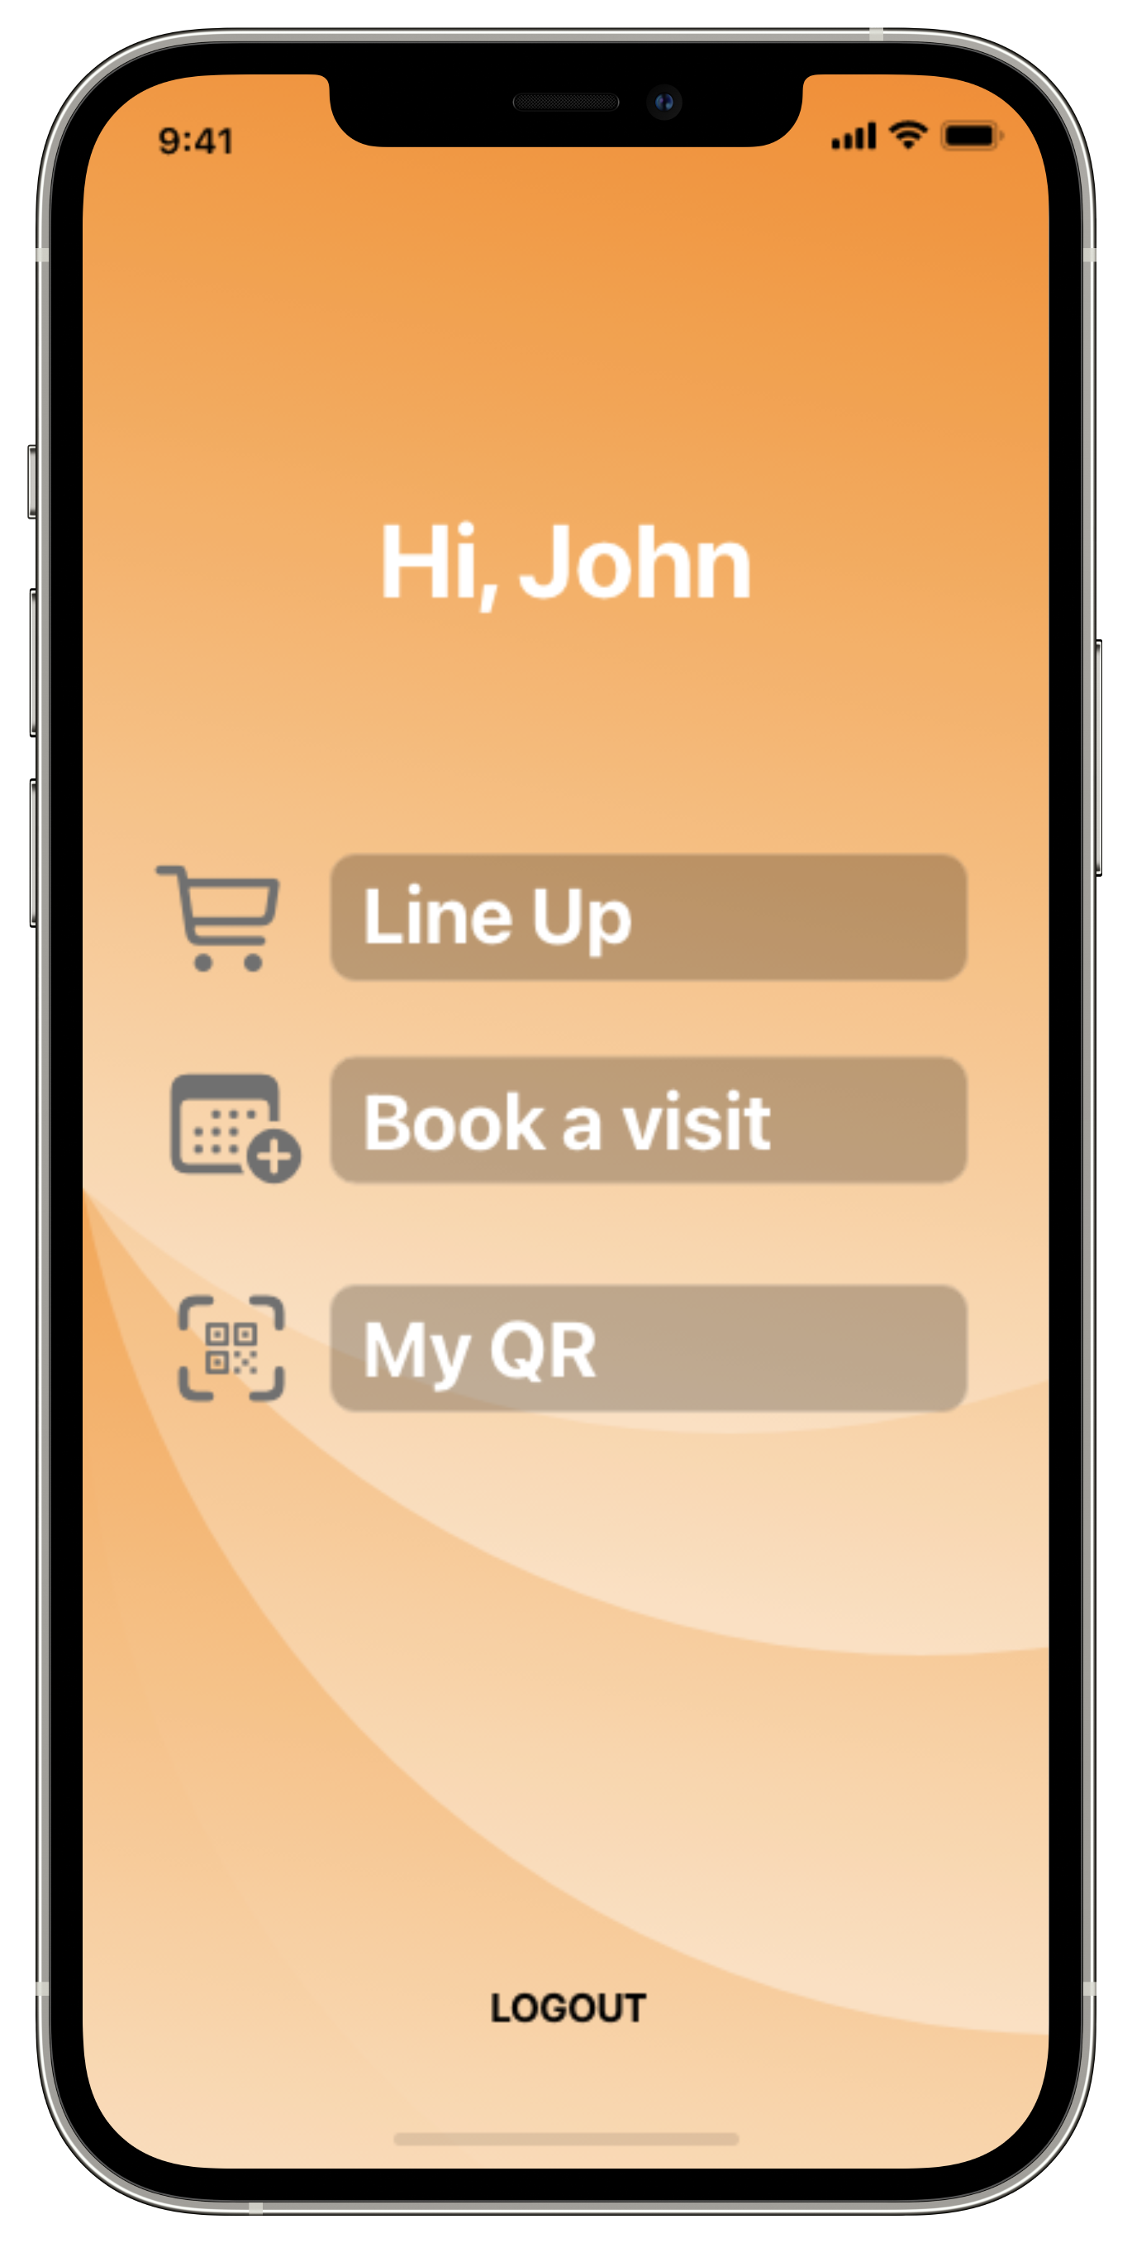
APPLICATION COMPONENTS
CUSTOMER MOBILE APPLICATION

Slide 18
APPLICATION COMPONENTS
NEXT-UP APPLICATION

Slide 19
APPLICATION COMPONENTS
PHYSICAL TICKET DISPENSER APPLICATION

Slide 20
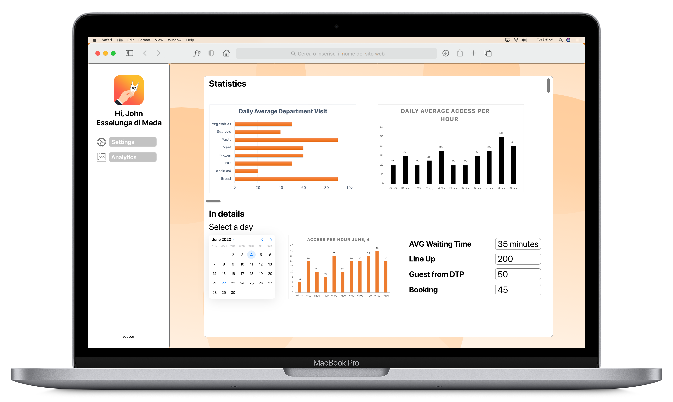
APPLICATION COMPONENTS
STORE MANAGER
WEB APPLICATION

Slide 21
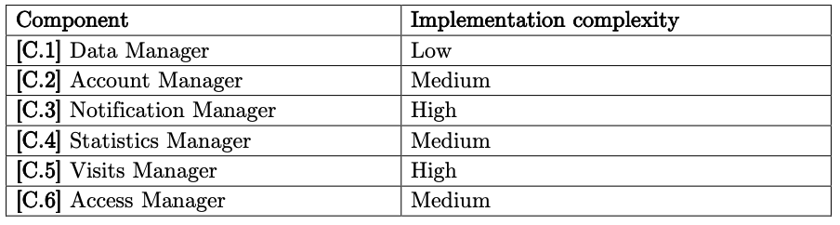
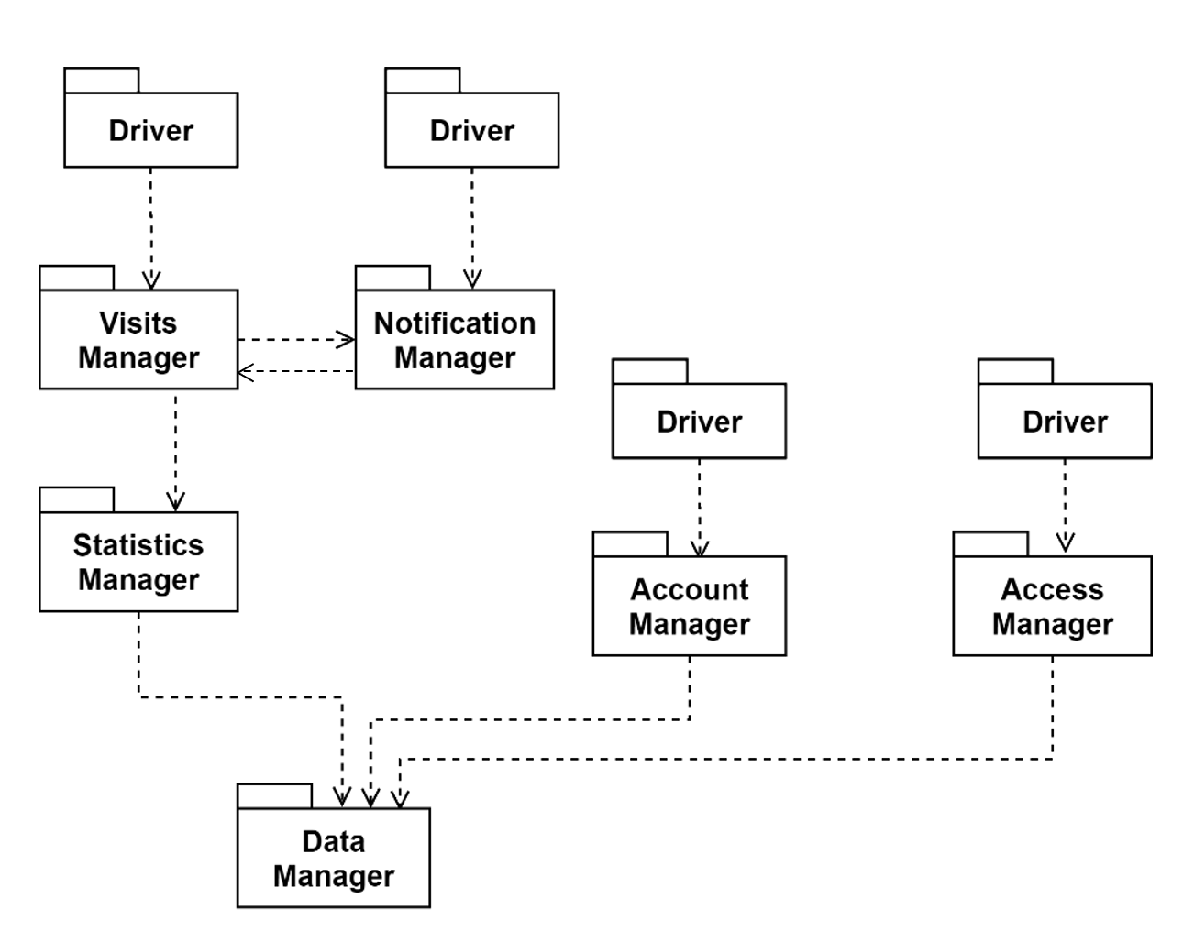
IMPLEMENTATION, INTEGRATION AND TEST PLAN
A bottom up approach.

Slide 22
CLUP
1st February 2021

